Slide 1
Autoencoder
Darin Momayezi

Slide 2
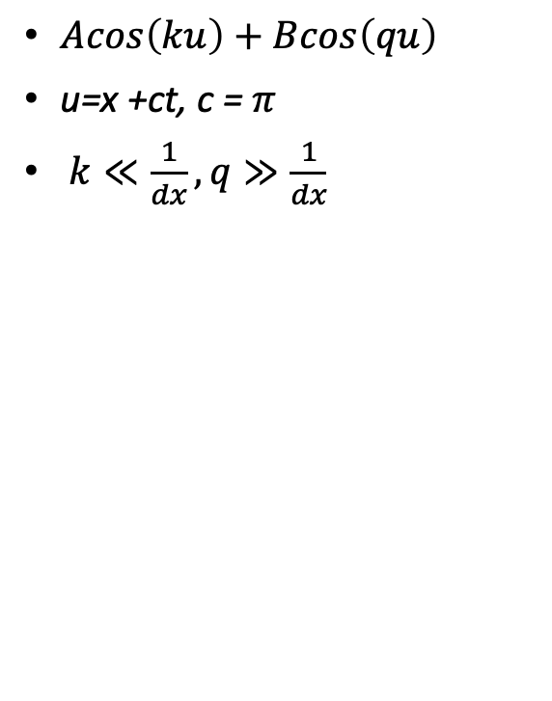
1D-PDE Model
$Acos\left(ku\right)+Bcos\left(qu\right)$
u=x +ct, c = $π$
$k≪\frac{1}{dx}, q≫\frac{1}{dx}$
Train/Test Split = 2/3, 1/3 of data, respectively.
https://github.com/darin-momayezi/Autoencoders/blob/5c3ba1892f409decefc082e8095ef37236e4e258/1D_PDE_Autoencoder.py

Slide 3
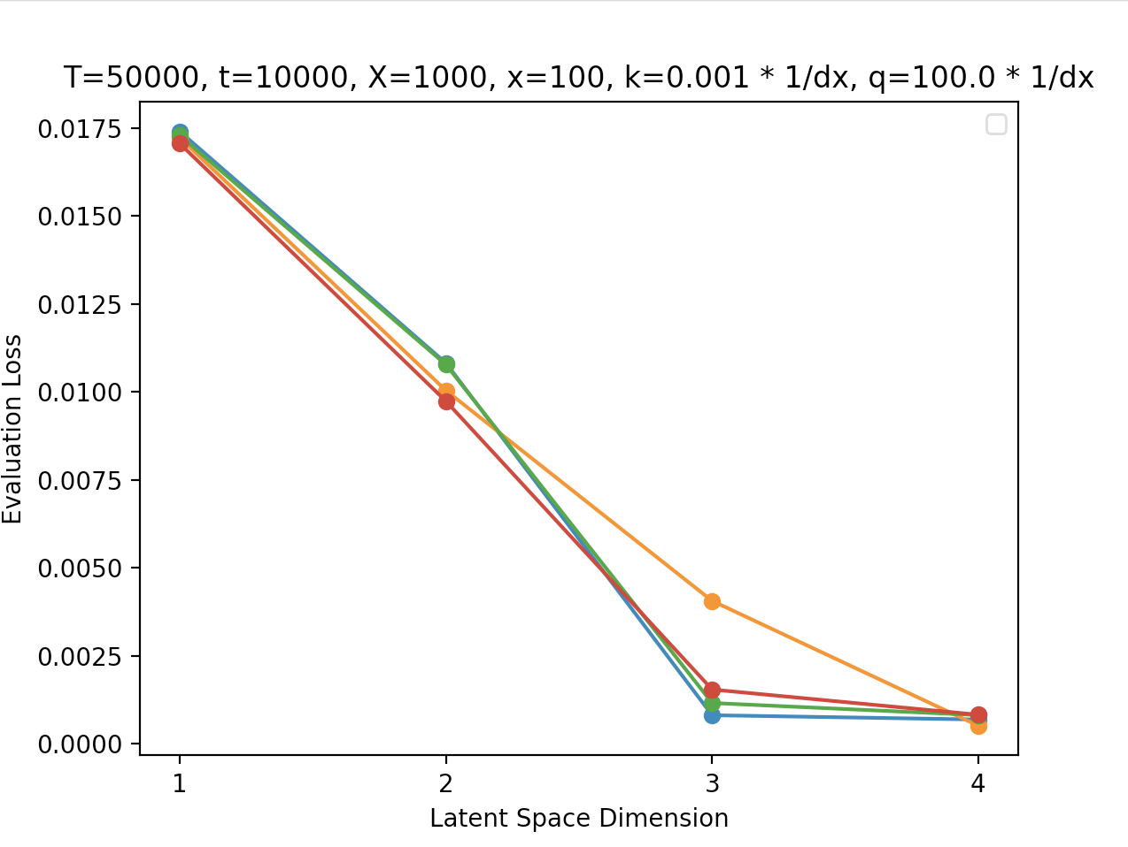
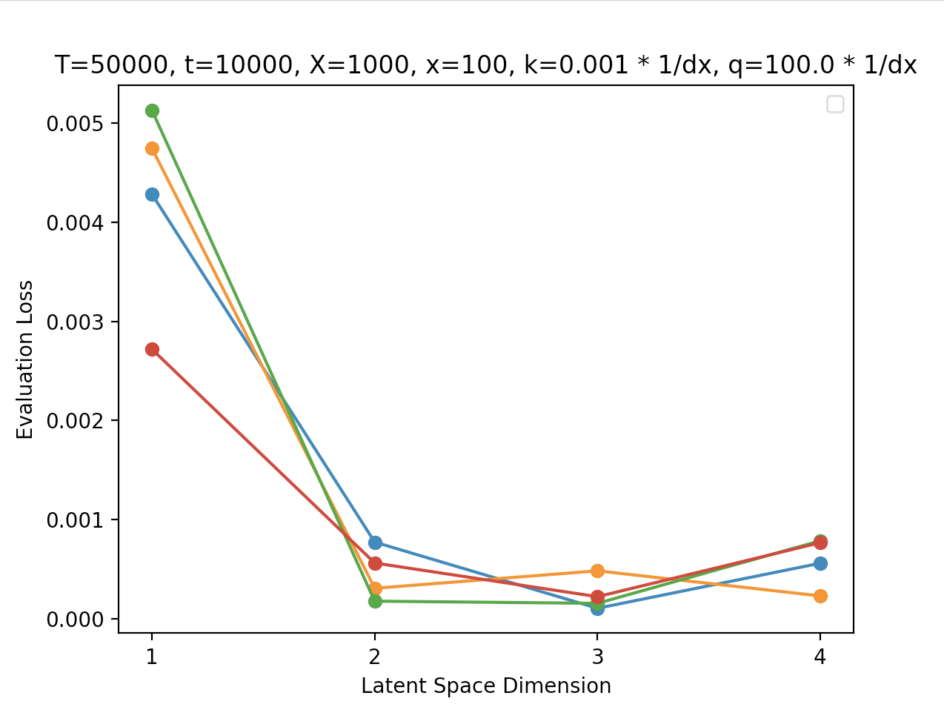
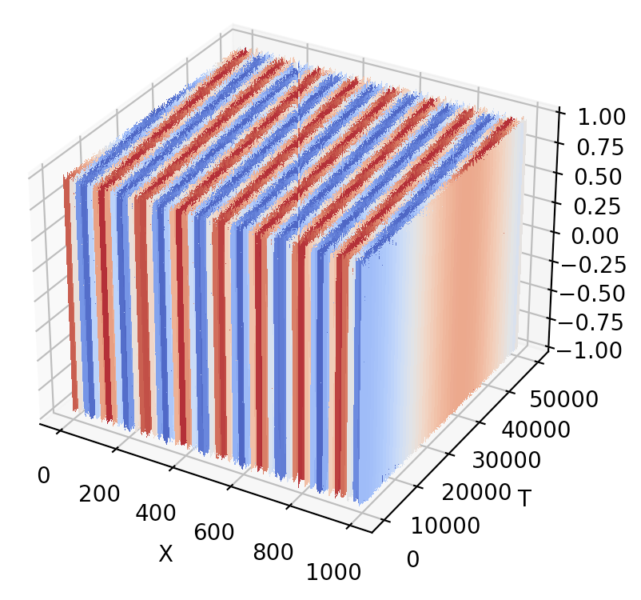
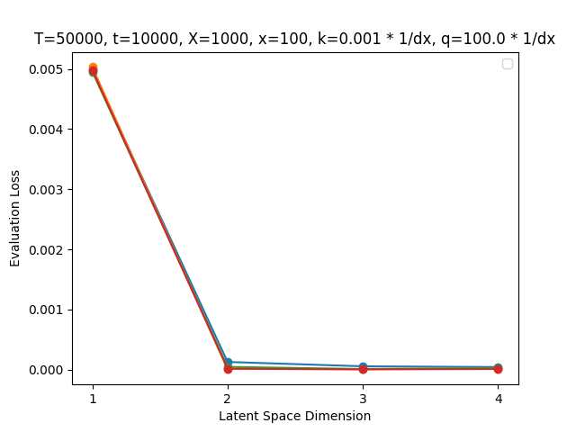
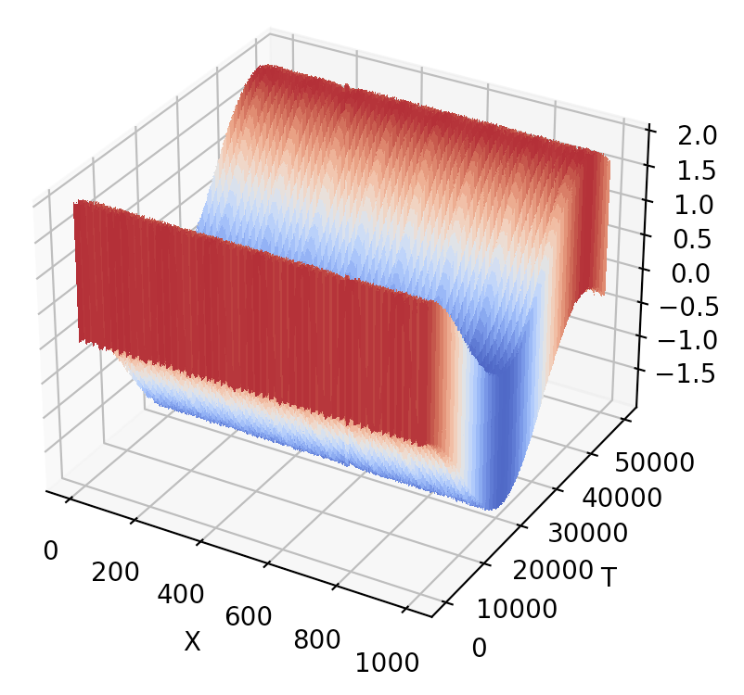
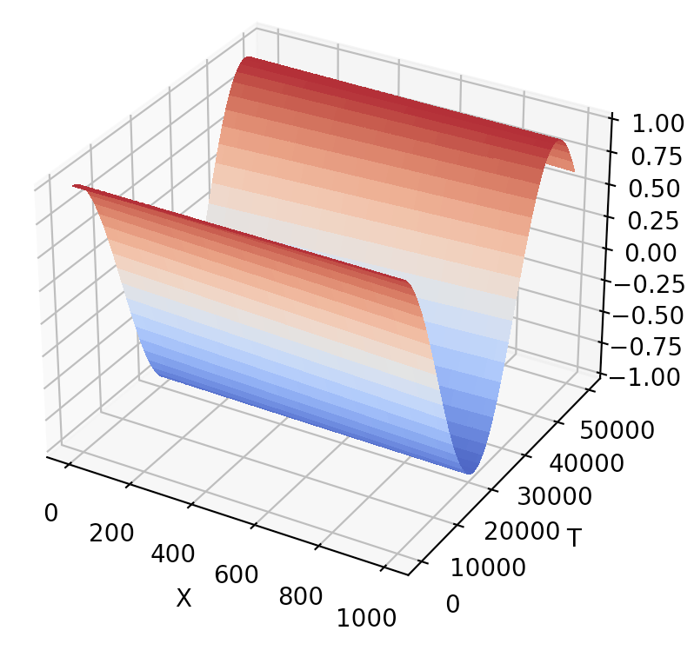
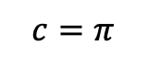
A = B = 1
A = 1, B = 0
A = 0, B = 1
$$c=π$$

Slide 4
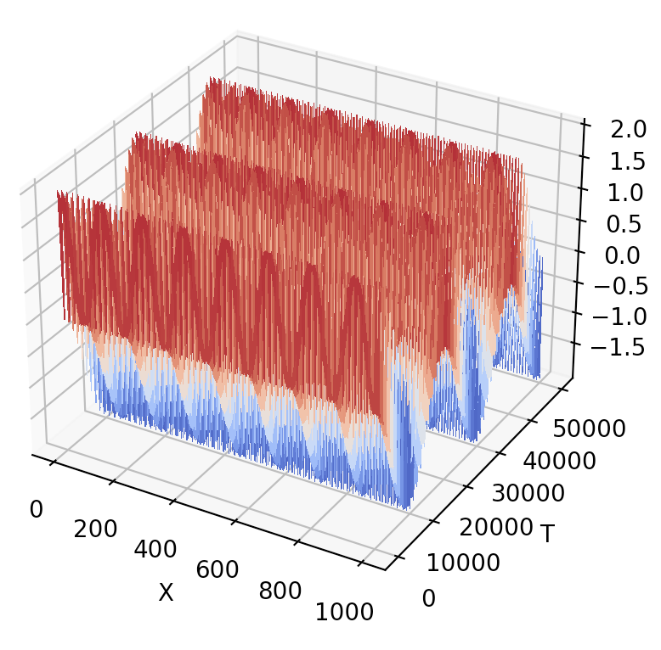
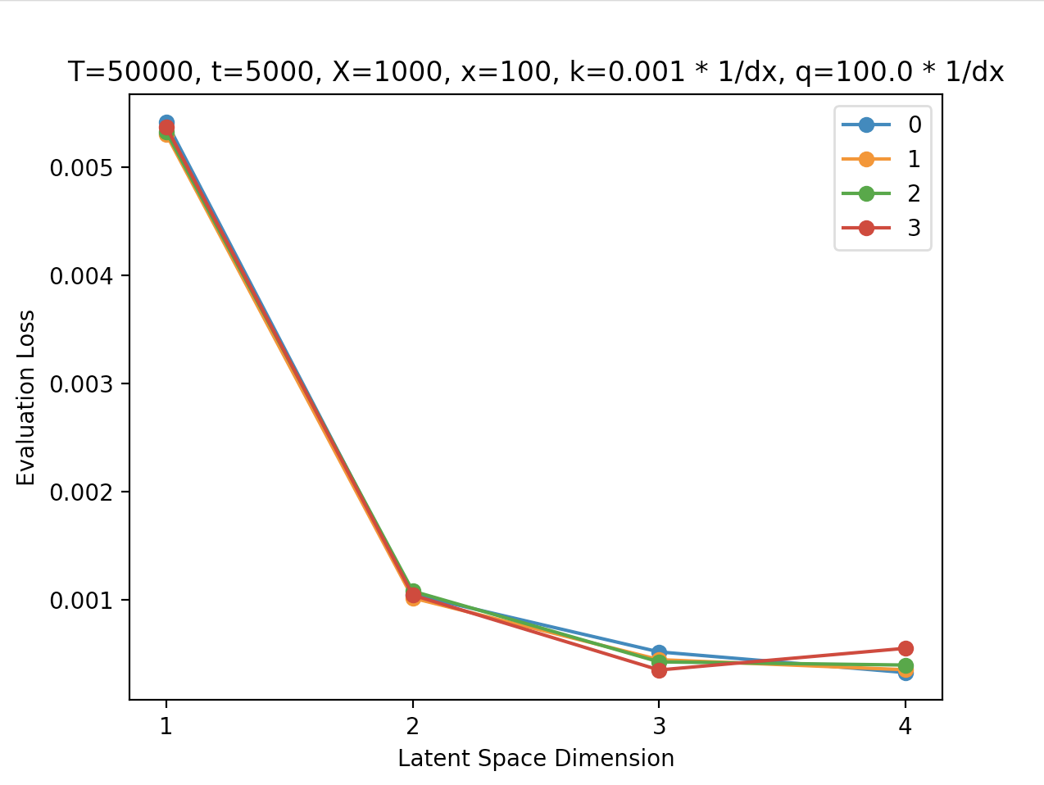
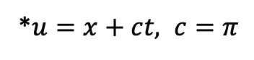
W/ Dynamic Mode Decomposition (DMD)
*$u=x+ct, c=π$

Slide 5
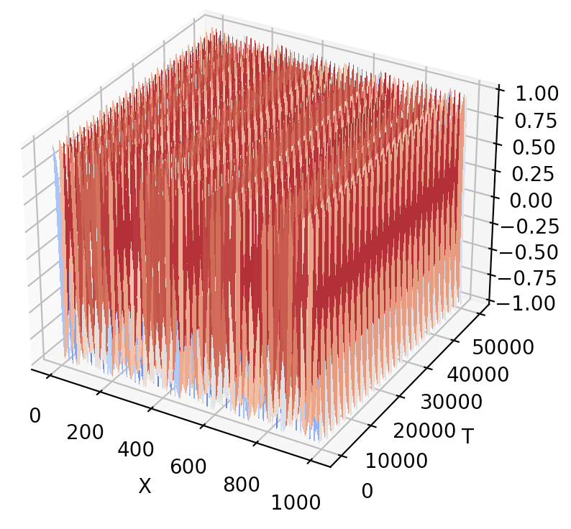
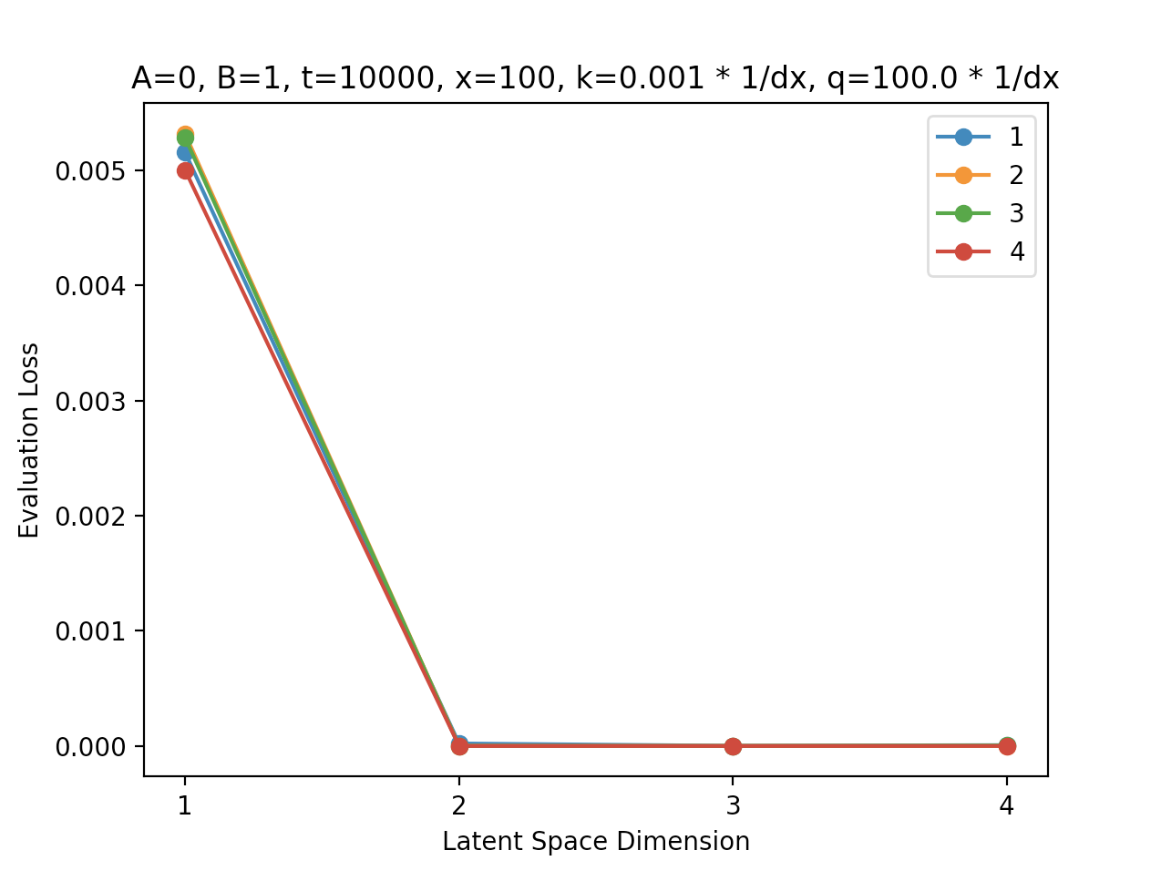
W/ Dynamic Mode Decomposition (DMD)
*$u=x+ct, c=π$

Slide 6
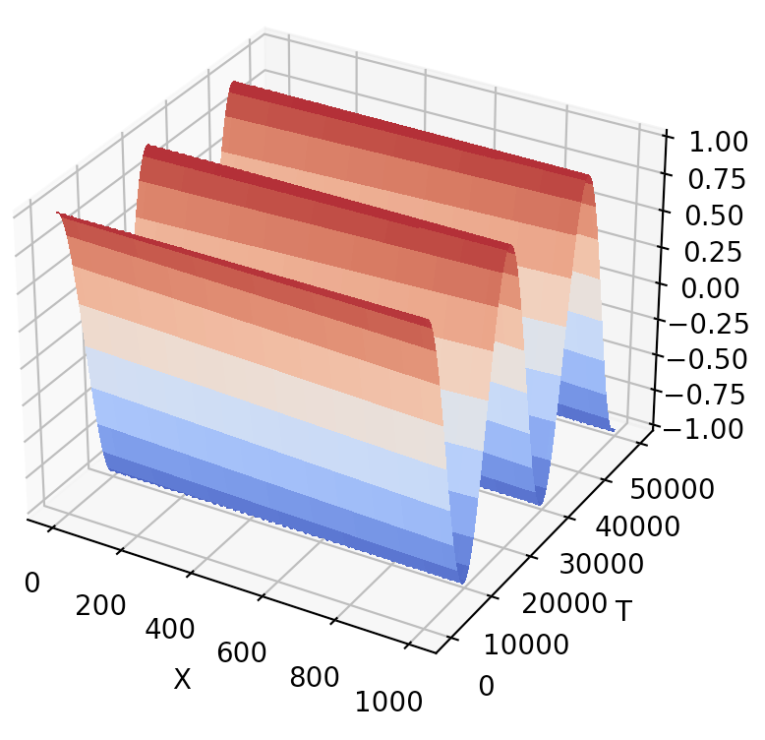
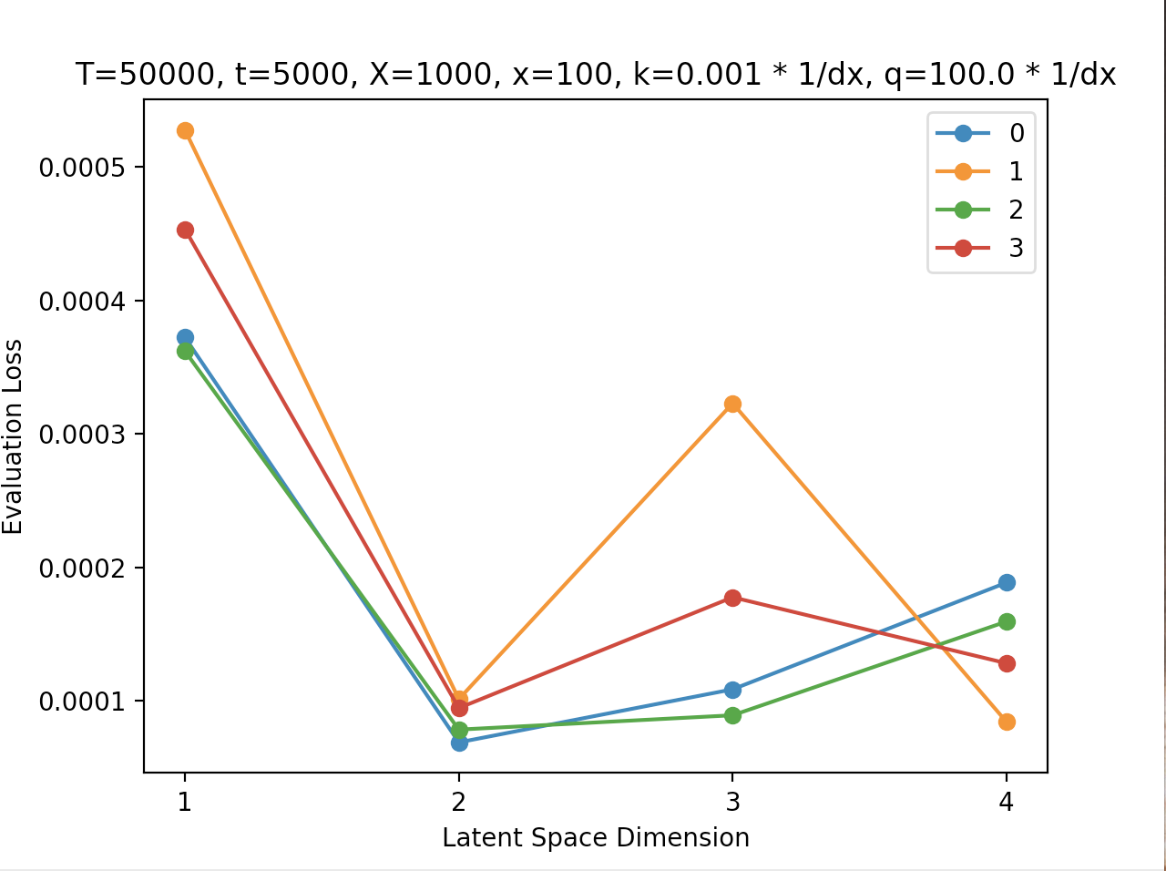
W/ Dynamic Mode Decomposition (DMD)
*$u=x+ct, c=π$

Slide 7
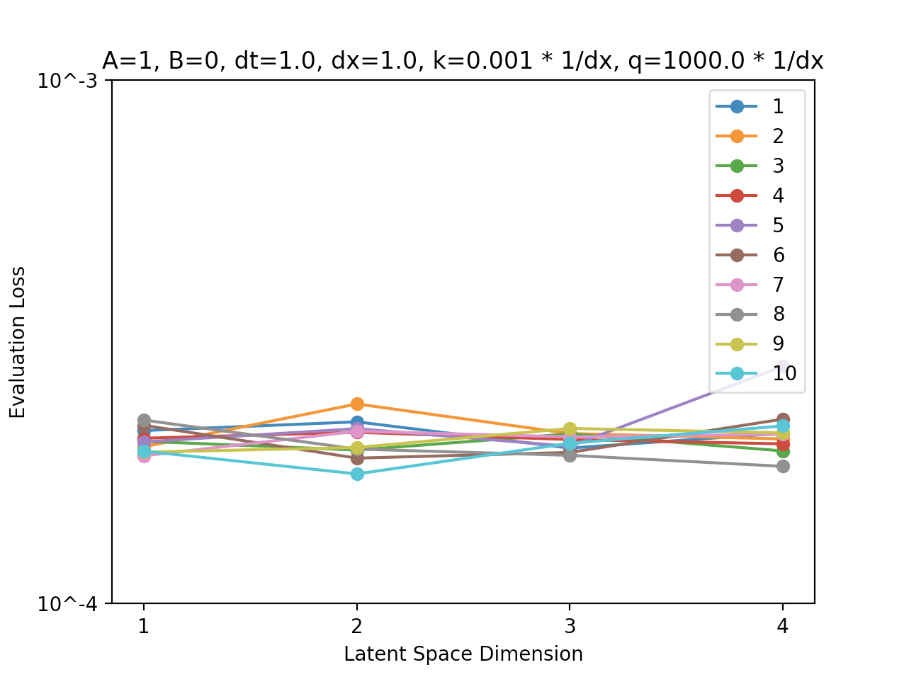
Perfect Resolution: Low Frequency

Slide 8
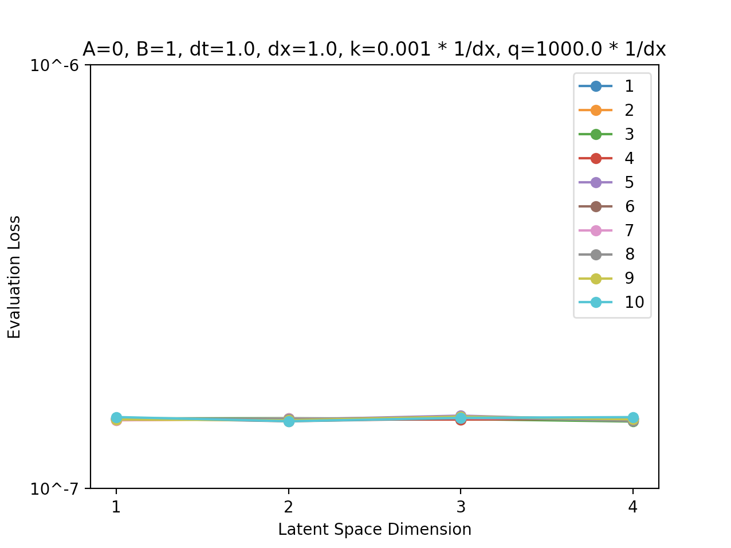
Perfect Resolution: High Frequency

Slide 9
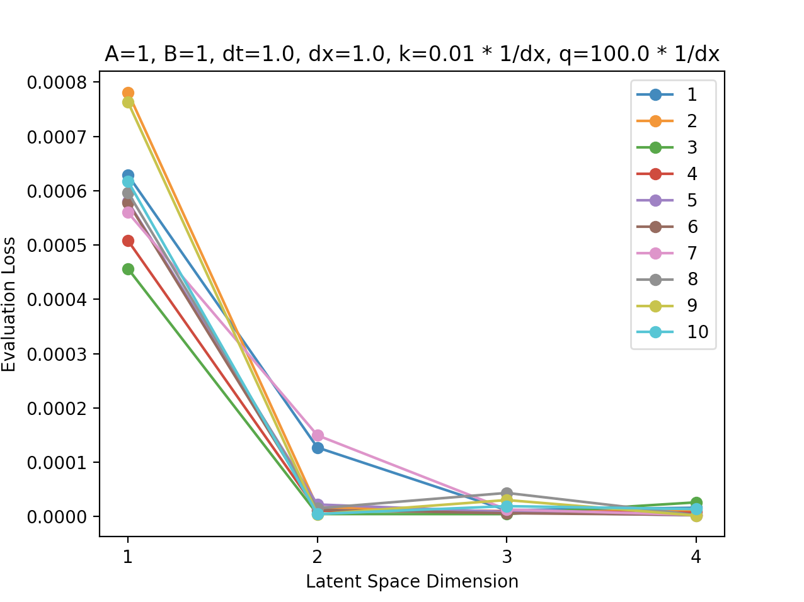
Perfect Resolution: Complete Solution

Slide 10
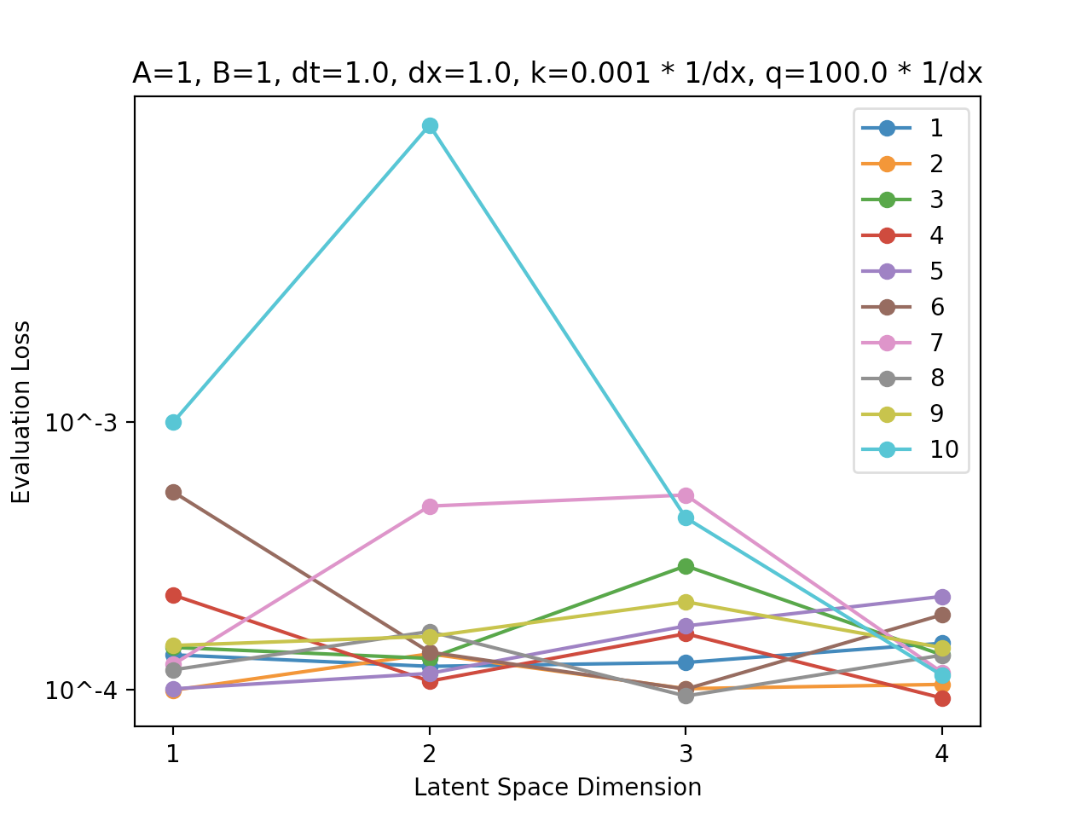
W/o Shuffling

Slide 11
Specifics
Weight decay
ReLU
Integer time/space steps (np.round(time/space step, 0))
Train/Test Split = 0.7/0.3

Slide 12
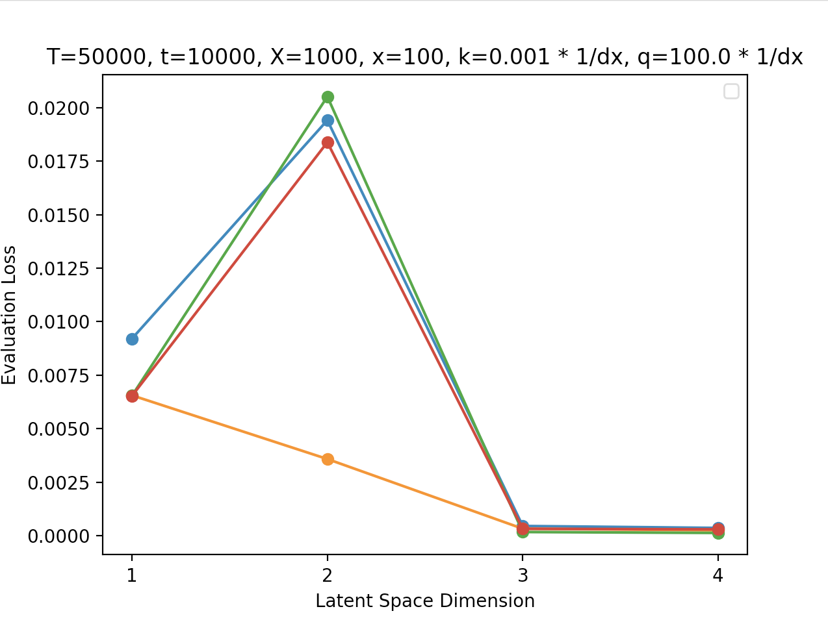
Different Evaluation Sections of Data
A=B=1

Slide 13
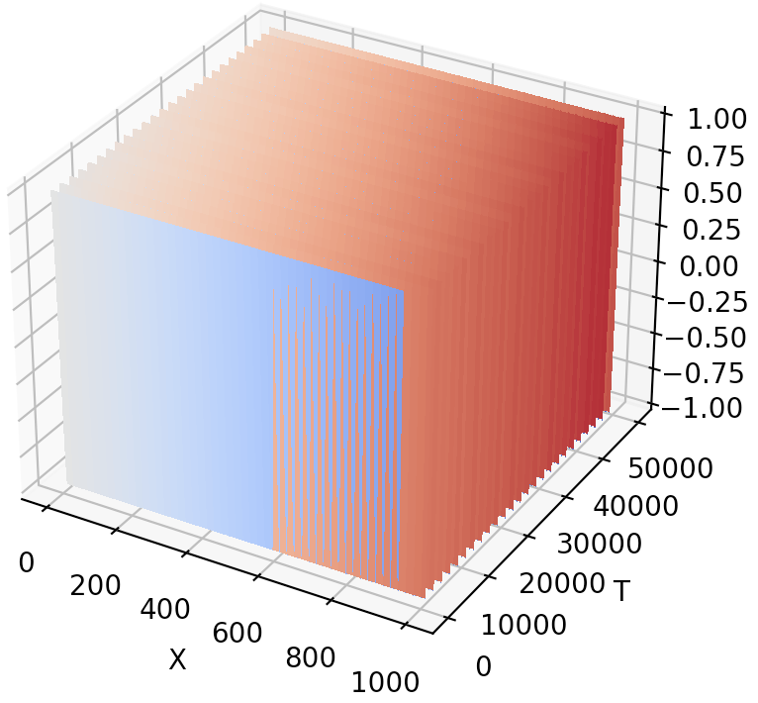
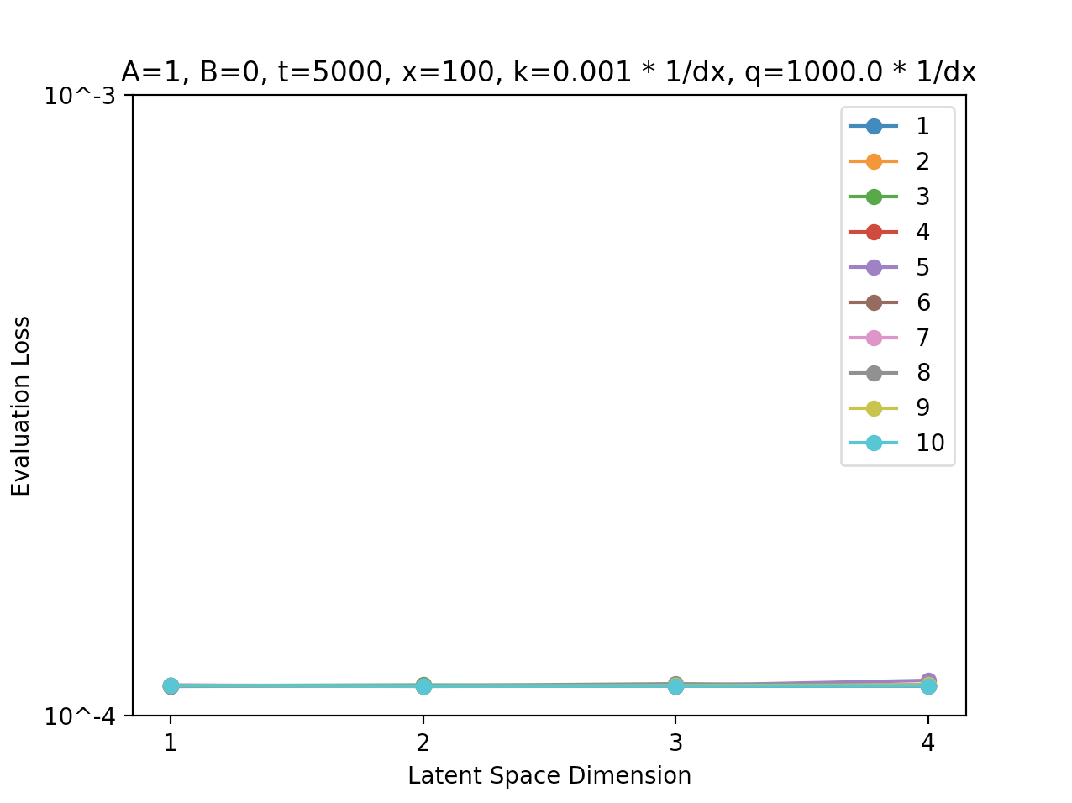
Low Frequency Component

Slide 14
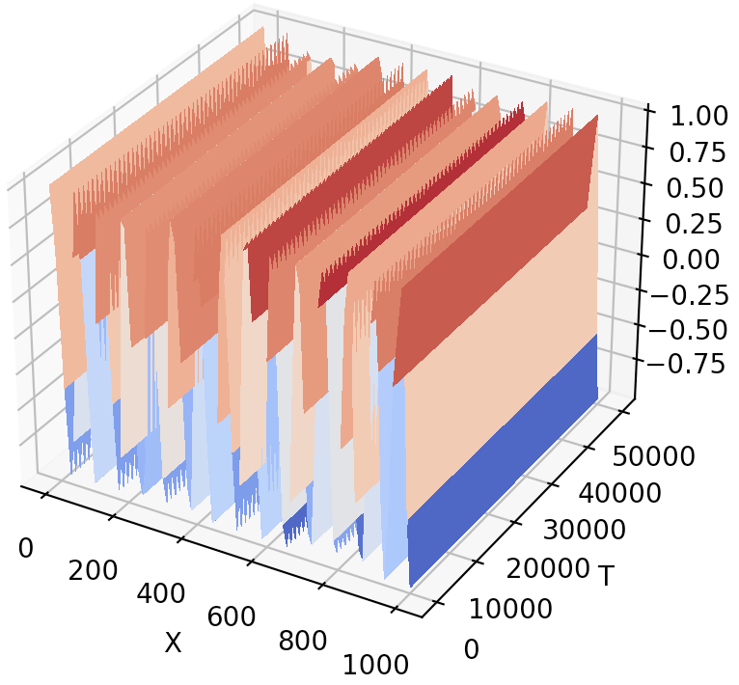
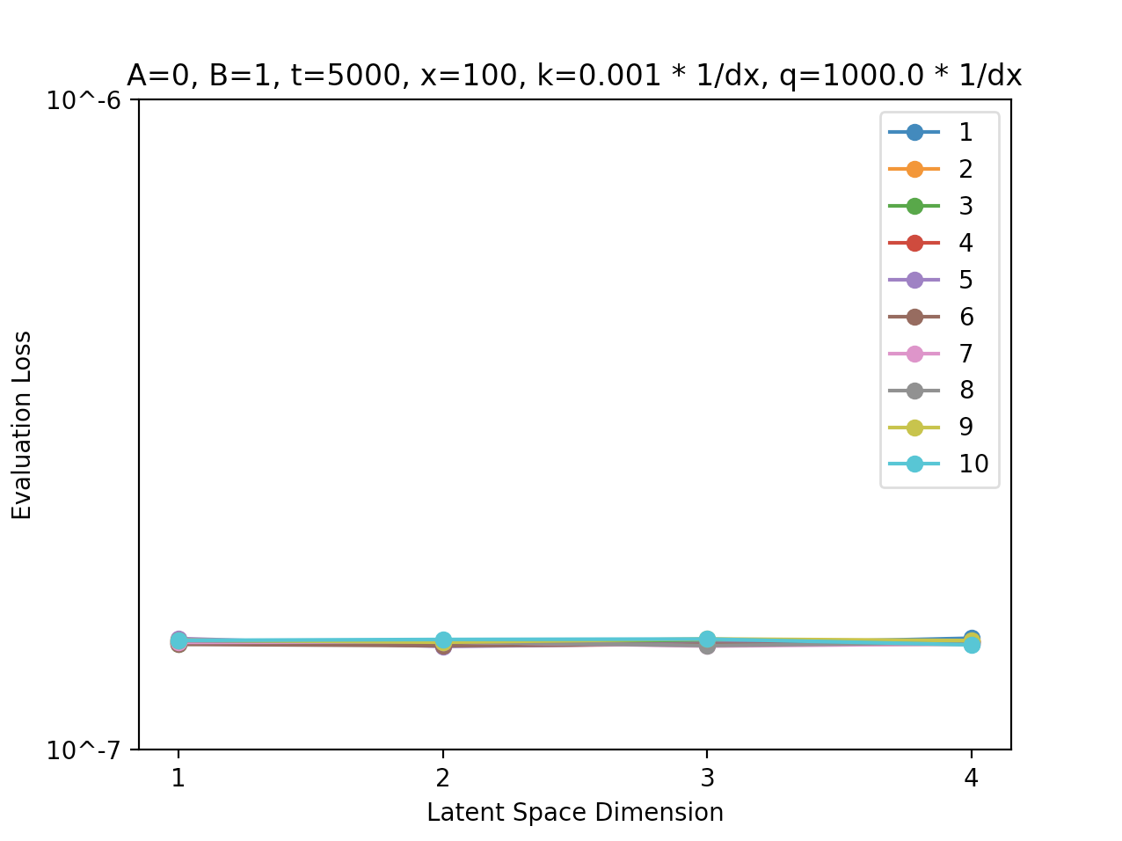
High Frequency Component

Slide 15
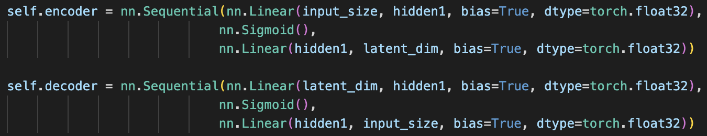
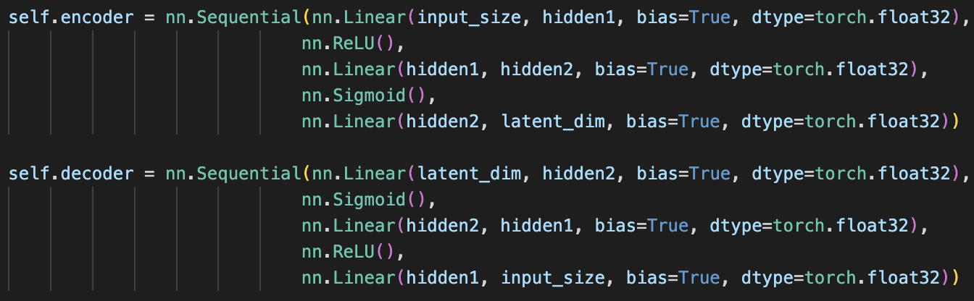
Shallow vs Deeper N. Net
Vs.

Slide 16
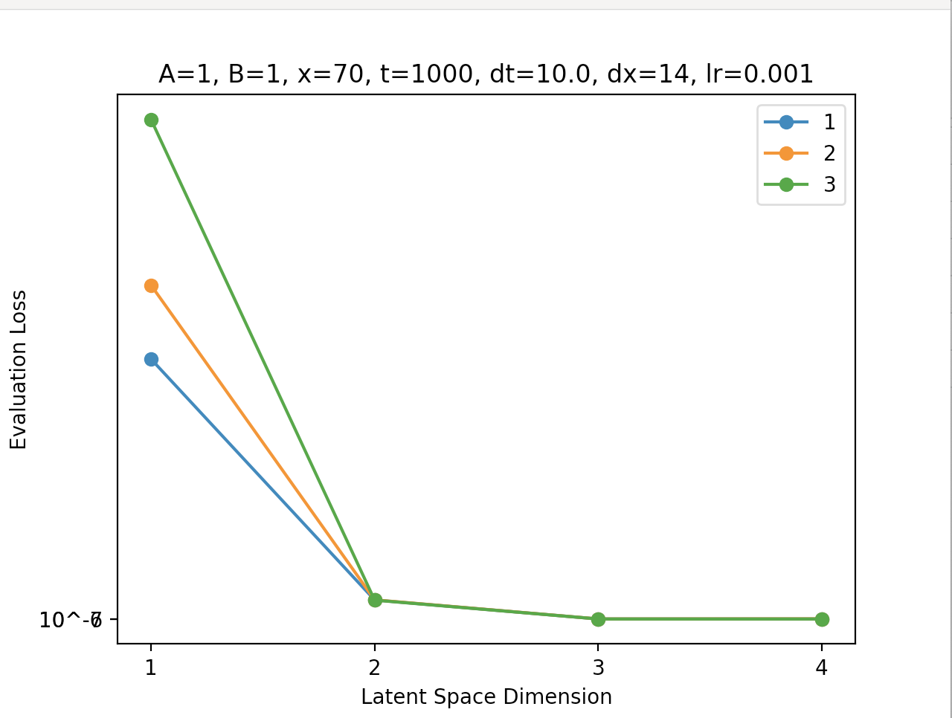
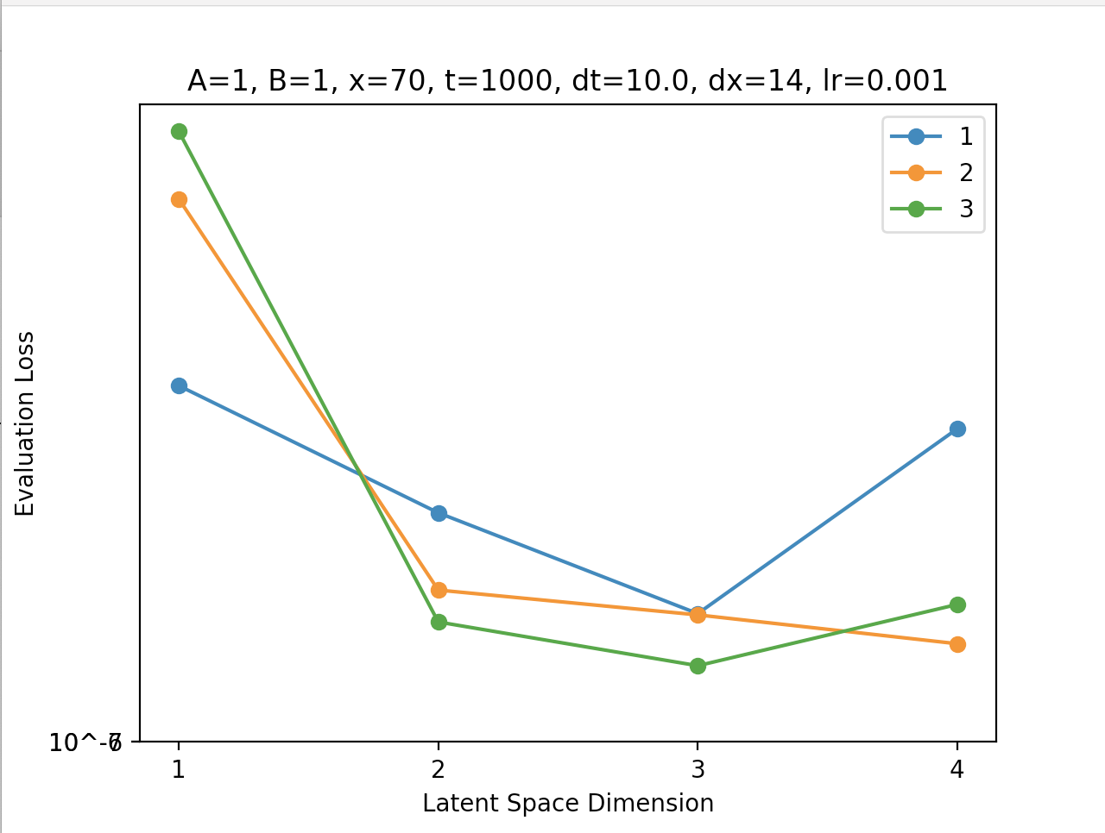
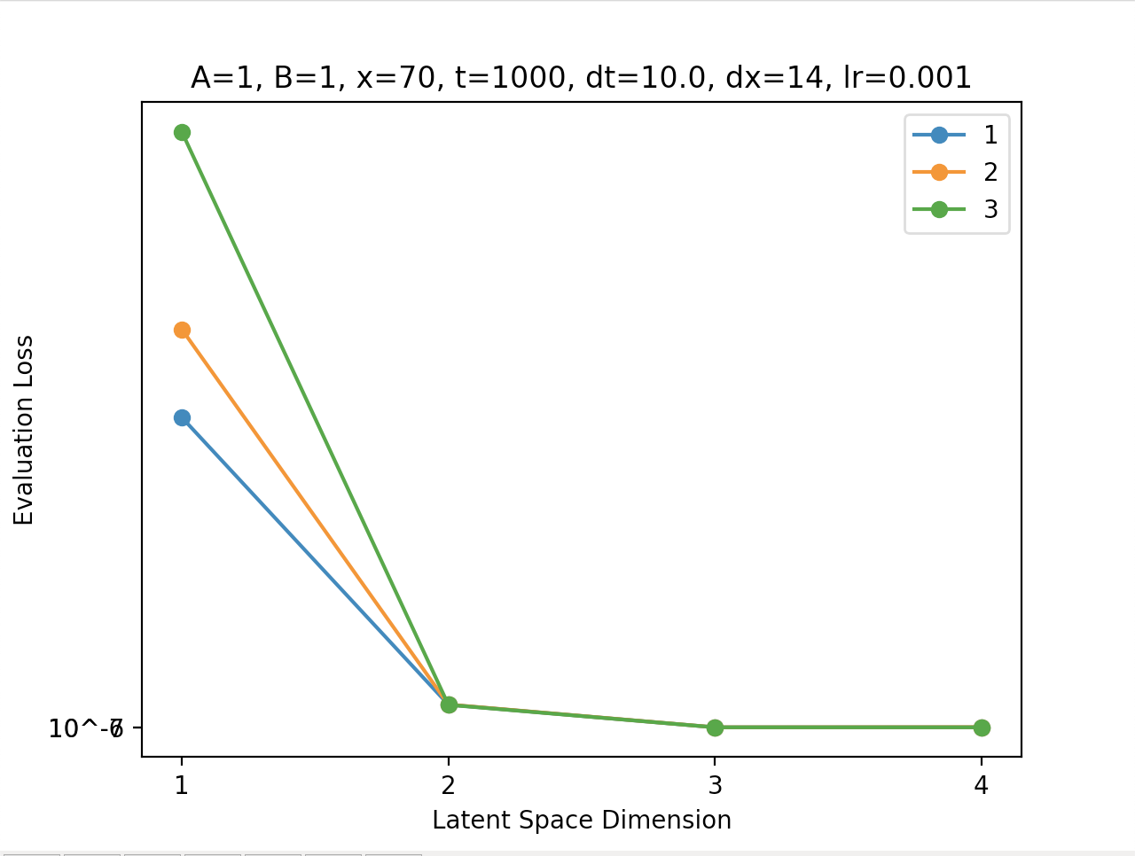
Shallow
Deep

Slide 17
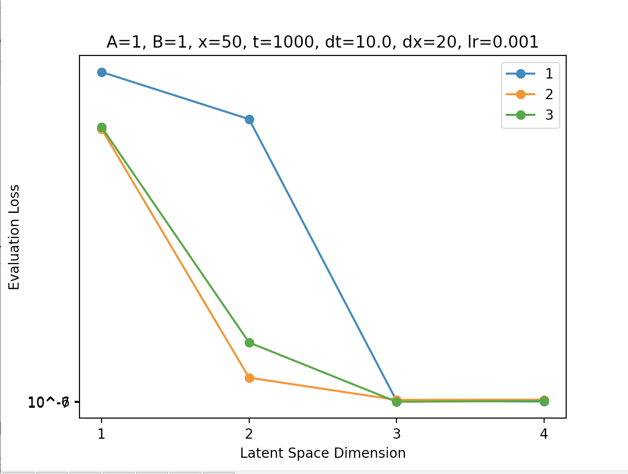
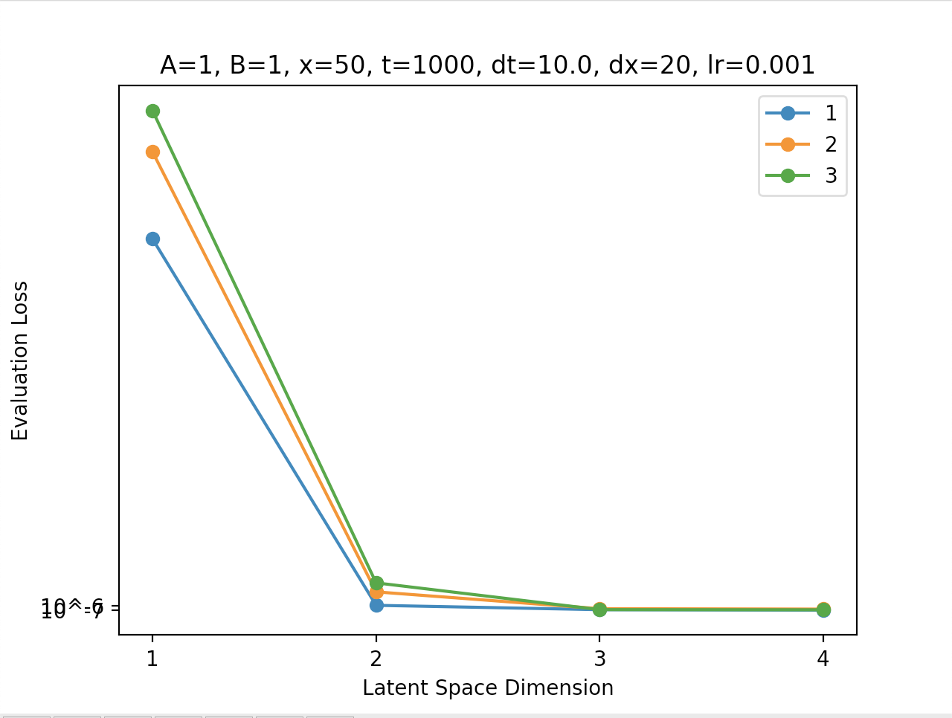
Single-Dim Vectors
High(3)-Dim Vectors

Slide 18
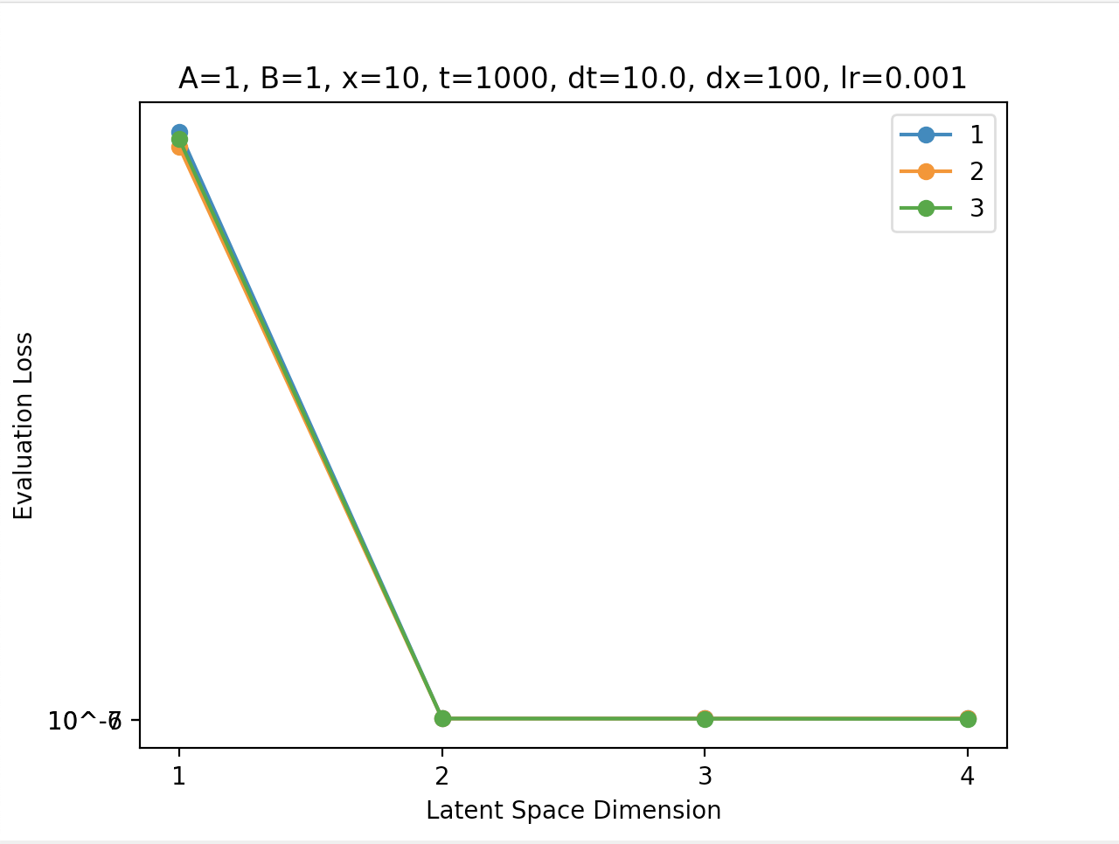
Shuffle=True,
Shallow,
Sigmoid

Slide 19
High-Dimensional Input Vectors

Slide 20
2D Navier Stokes CNN

Slide 21
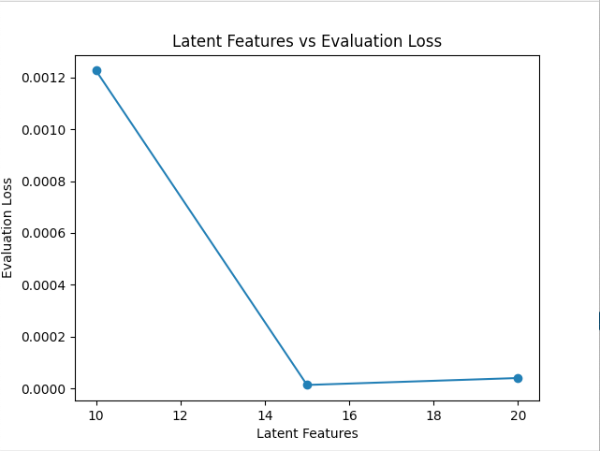

Slide 22
64
64
1
2
3
8
16
512
24
32
40
48
…
512

Slide 23
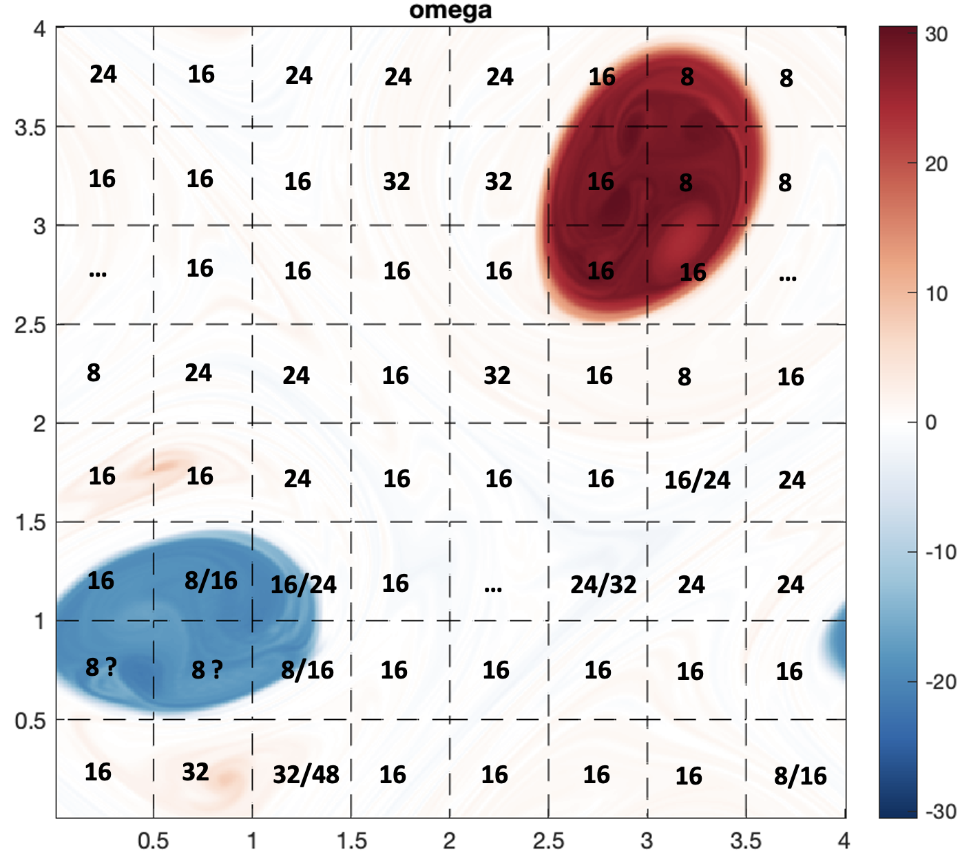
Subdomain Latent Dimensions
Use time-averaged vorticity

Slide 24
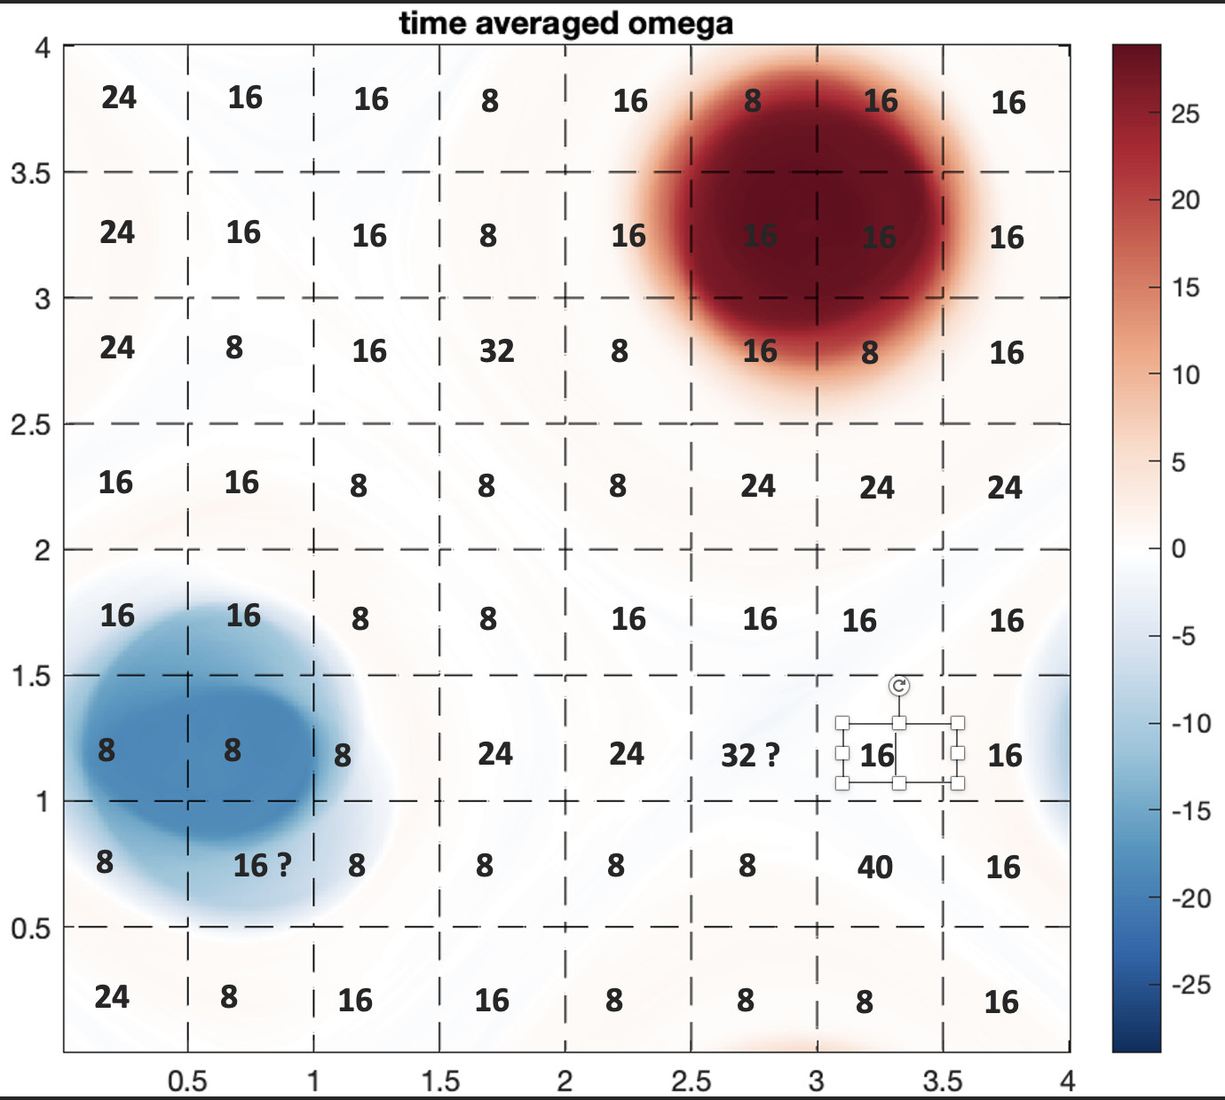
Subdomain Latent Dimensions

Slide 25
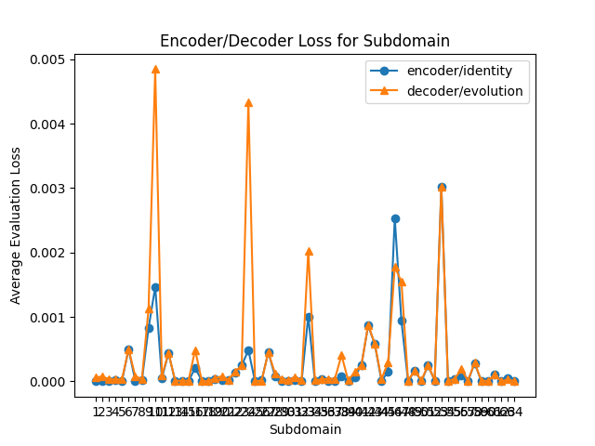
Encoder/Indentity-Decoder/Evolution

Slide 26
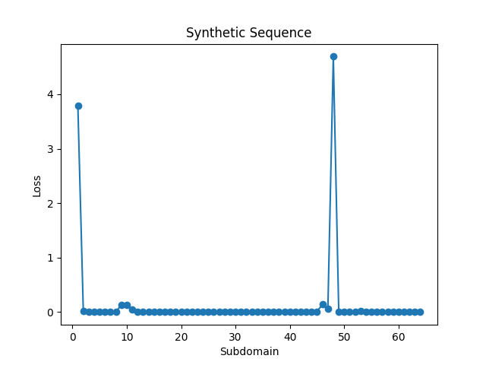
Synthetic Sequence

Slide 27
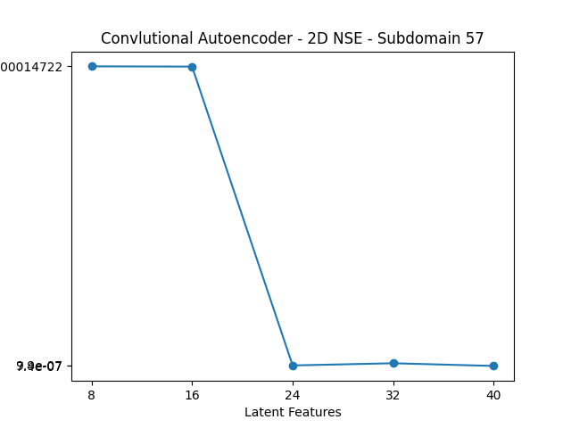
Difference between this graph…
We sometimes need smaller latent dimensions and smaller intervals between them.

Slide 28
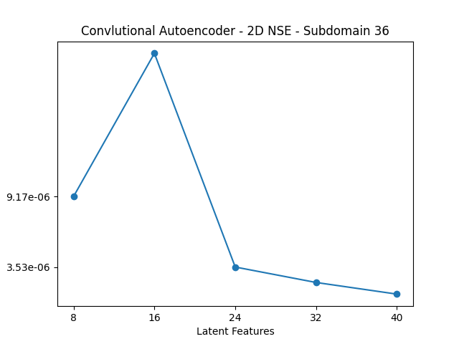
And this one…

